Slide 1
Introduction to programming COSC 2511
Week 2
Algorithmic solutions, datatypes, variables, arithmetic operators
Notes:
Instructions
To create em dash above headline Same size and weight as the headline and set using a soft return. PC: Em dash (—): Alt+Ctrl+ - (minus) Mac: Em dash (—): Shift+Alt/Option+hyphen

Slide 2
Recap Week 1
Last week we looked at programming fundamentals including:
an introduction to java
a selection of computer problems and considered how to solve these problems using a step-by-step process called an algorithm.
This week we start to consider how these algorithms might be converted into simple computer code, in this case using Java.

Slide 3
Lecture Overview
Data Types
Variables
Operators
From Algorithm to Coding
Introduction to Git

Slide 4
Tutorial Overview
Installation of Git
Coding with Variables
Writing Algorithms then coding your algorithm
Reflection Quiz

Slide 5
Data Types
In Java we need to clearly identify the type of data that we are using in a program. These can be broken down into two groups:
Primitive Data Types:
int, char, float, double, boolean
Non-primitive Data Types:
String, Arrays, Scanner, Classes

Slide 6
Data Types
A primitive data type is the most basic data type in java. These data types only serve a single purpose which is to contain the data of a certain kind.
int – contains whole numbers (15, -25)
float – used when you need a decimal number (10.5, -5.48)
double – same as float, but can go to 16 decimal digits. Float can only go to 6 or 7
char – used to store a single character (A, f)
boolean - used for True or False statements
Note: you can see all the primitive data types here

Slide 7
Data Types
A non-primitive data type (aka reference types) refers to a complex data type referencing a class rather than a data type that is built into the Java language.
The main difference is that primitive data stores actual values whereas non-primitive data is stores references to an object in memory.
String – used to store a sequence of characters such as a word or phrase (“Hello There”).
Array – a group of like-typed variables organised together and share a common name. We will be looking at this more closely in weeks 6/7

Slide 8
Data Types
Primitive data types always start with a lowercase letter – int
Non-primitive data types always start with an uppercase letter – String, Array

Slide 9
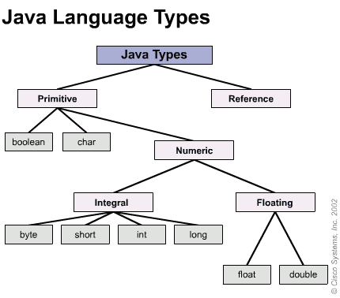

Slide 10
Variables
Every programming language needs to store a piece of data as part of a program. Such data are store in location of memory called Variables.
A variable, as the name implies, can have the data it contains be modified while the program is running
One of the features of a programming language is the ability to define and manipulate variables.
A variable is a named location in memory that stores a value.
Values may be numbers, text, images, sounds and other types of data.

Slide 11
Variables
All variables must first be declared before they can be used.
To create a variable, you first have to declare a variable and the type of information to be stored in that variable.
For Example:
String message;
This statement is a declaration, because it declares that the variable named message is being created that has the data type String.

Slide 12
Variables
Each variable has a type that determines what kind of values it can store. For example, the int type can store integers, and the char type can store characters.
Some types begin with a capital letter and some with lowercase. We will learn the significance of this distinction later, but for now you should take care to get it right.
To declare an integer variable named x, you simply type:
int num;
Note that num is an arbitrary name for the variable. In general, you should use names that indicate what the variables mean.

Slide 13
Variables
For example, if you saw these declarations, you could probably guess what values would be stored:
String firstName;
String lastName;
int hour, minute;
This example declares two variables with type String and two with type int.
When a variable name contains more than one word, like firstName, it is conventional to capitalize the first letter of each word except the first.
Variable names are case-sensitive, so firstName is not the same as firstname or FirstName

Slide 14
Variables
You can use any name you want for a variable
However, there are about 50 reserved words, called keywords, that you are not allowed to use as variable names.
These words include public, class, static, void, and int, which are used by the compiler to analyse the structure of the program.
You can find the complete list of keywords at
http://docs.oracle.com/javase/tutorial/java/nutsandbolts/_keywords.html
but you don’t have to memorize them. Most programming editors provide “syntax highlighting”, which makes different parts of the program appear in different colors.

Slide 15
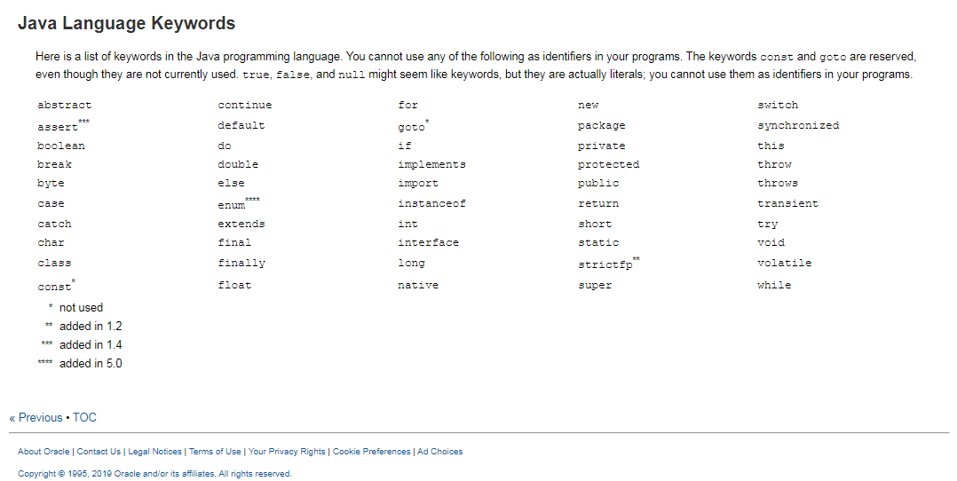
Keywords in Java.

Slide 16
Data Types
Literal data types are the values that we can assign to our variables without the use of a constructor (more on this much, much later).
These values cannot change data types, for example:
We can assign the value of ‘10’ to an int.
We cannot assign ‘a’ to int as int can only accept whole numbers.

Slide 17
Operators
There are a number of operators in Java. Some of them are Arithmetic operators, Relational operators, logical operators etc.
Arithmetic operators are symbols that help to do mathematical computations.
Examples:
Addition operator is +,
Subtraction is -,
Multiplication is *,
Division is /,
Remainder is %
We will see other operators later

Slide 18
Arithmetic operators
Remember that the order of precedence is indicated by the acronym BODMAS:
Brackets, Order of, Division, Multiplication, Addition and Subtraction
If the operators have the same precedence, they are evaluated from left to right.
Any time you want to override the order of operations (or you are not sure what it is) you can use parentheses. Expressions in parentheses are evaluated first, so (1 + 2) * 3 is 9.

Slide 19
Assignment and Concatenation
In Java means = sign means assignment
We use this to assign data (contents) from the left hand side to a variable on the right hand side.
String name = “RMIT University”;
Here the data or contents “RMIT University” is assigned to a String variable called name;
Similarly + sign would mean add from a mathematical operators are used. When combined with non numeric data + sign becomes a concatenator (join) symbol
int num = 22;
String value = “Age of student is ” + num;
In the above example + sign is a concatenator i.e. in this case joins the String value to the numeric variable num with output:
Age of student is 22

Slide 20
From algorithm to coding
Example:
Declare 4 memory boxes – num1, num2, num3, and total – all of type int
Assign values to each memory location
Add all the numbers into total
Print what is in each currently.
Print the final total.

Slide 21
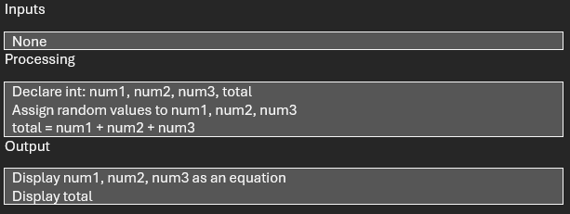
From algorithm to coding
Example:

Slide 22
Code and output
CODE:
public class AddNumbers {
public static void main(String[] args) {
// Program to add 3 numbers and print the results
//declare 4 memory boxes (variables)
int num1, num2, num3, total;
//assign values to each variable
num1 = 5;
num2 = 10;
num3 = 15;
//add all numbers into total
total = num1+num2+num3;
//print numbers and total
System.out.println("Sum of "+num1+", "+num2+", "+num3+" is "+total);
}
}
Output:
Sum of 5, 10, 15 is 30

Slide 23
CONSTANTS
final int MONTHS_IN_YEAR = 12;
final double GST = .10
Use upper case letters for all constants.
final <datatype><CONSTANT_NAME>
Once the value of the constant is defined, it cannot be changed.

Slide 24
Naming Rules
Variable name, class name, method name are called identifiers
There are rules for valid names:
Name may contain digits and letters
Must start from a letter, not from digit
May contain $ (dollar sign) and underscore _
cannot contain the symbols % (percentage)
# (number symbol), @.
cannot contain any special characters and operators (+,-,/. etc)
cannot use keywords.

Slide 25
Git
Git is a powerful repository that was created by Linus Torvalds (the guy who created Linux) in 2005.
A version control system (like google docs/office 365)
Uses branches to work on new features while preserving existing code.

Slide 26
GitHub
A cloud-based service where developers can upload and share their code.
It allows developers to work together and manage projects and tasks.
You will need to create an account in your tutorial class. You will need to use your RMIT email address.

